Slide 1

CITY COUNCIL
PREPARED BY:
Parin Zala(92200938201)
Sneh Faldu(92200938211)
Nihar Trivedi(92200938213)
Jay Ramani(92200938214)
Jyotin Tank(92200938241)
MARWADI UNIVERSITY
FACULTY OF DIPLOMA STUDIES
COMPUTER
ENGINEERING
DEPARTMENT
5th Sem
Project Review 1
GUIDED BY:
Prof. Miral Seladiya
Assistant Professor

Slide 2
Content
Abstract
Aim / Objectives
Specific Requirements(Software/Hardware)
System Design(Diagrams)
List of Tables
Reference and Sources

Slide 3
Abstract
Goal: Build an easy-to-use online platform for efficient access to city services.
User Features:Sign up to report non-urgent issues, access public health services, and find local educational info.Book public function halls and manage tasks like property taxes and certificates . Chatbox for inquiries and feedback submission.
Employee Functions: View and manage incoming requests (status updates: Pending, In Progress, Completed).Communicate with customers via messages.
Admin Controls :Manage employee accounts and view customer service requests. Monitor service requests.

Slide 4
Aim / Objectives
The City Council's online platform provides access to a variety of city services in one place, allowing citizens to report non-urgent issues, find information about public health, schools, and universities, and book public halls or pay taxes.
Citizens can request official documents, such as birth and death certificates, through the platform, saving time and effort by avoiding multiple websites or office visits.
The platform is user-friendly and accessible for all, regardless of technological familiarity.

Slide 5
Aim / Objectives
City employees can log in to manage service requests from citizens, update their status, and communicate directly with them for further updates or information.
Administrators will have tools to manage employee accounts, view service requests.
The platform aims to enhance efficiency in city operations, improve communication between the city and residents, and provide a positive user experience

Slide 6
Specific Requirements
Server Hardware Interface
1. Logical Characteristics:
The server handles incoming client requests (users, employees, admins), managing data storage, processing, and network communication. It processes service requests, payments, while managing user sessions and background tasks like request status updates.
2. Physical Characteristics:
The server hardware can be physical or cloud-based (e.g., AWS, Azure), supporting web servers and databases like Apache, Nginx, MySQL, or PostgreSQL, with Ethernet or Wi-Fi connectivity for internet communication.

Slide 7
Specific Requirements (Hardware)
Client Devices Interface
1. Logical Characteristics:
Client devices (PCs, smartphones, tablets) access the platform via a web browser with the software interacting through the device's web browser or operating system to display the UI, process inputs, and handle data transmission. This involves sending requests to the server, receiving responses, and rendering web pages.
2. Physical Characteristics:
Supported devices include any internet-enabled device with a modern web browser (e.g., Chrome, Firefox, Safari) and a stable internet connection (Wi-Fi, 4G/5G, Ethernet) for server interaction. No special hardware is required beyond standard computing devices.

Slide 8
Specific Requirements (Hardware)
3. Special Libraries:
The front-end may use libraries like React.js or Angular.js to enhance the user experience, while mobile apps could leverage React Native or Flutter for interface development. Secure communication is ensured through HTTPS protocols, potentially using librarie

Slide 9
Specific Requirements (Software)
1. Operating System Interface:
Supported Operating Systems:
Linux (e.g., Ubuntu, CentOS) • Windows Server
macOS (for development purposes, if necessary)
2. Process Management:
The City Council platform relies heavily on the operating system to manage the execution of various processes. These include the web server, database server, and any background tasks that may be necessary for the operation of the platform.

Slide 10
Specific Requirements (Software)
3. File System Interaction:
Interaction with the file system is another critical aspect of the platform’s operation. The software reads and writes several types of files, including configuration files, log files, and temporary data. These files are stored on the operating system’s file system, and proper management of these files is essential for smooth operation..
4. Network Communication:
Network communication is handled through the operating system’s network stack. This includes processing all incoming and outgoing HTTP/HTTPS requests, interacting with external APIs, and managing secure connections. The operating system manages the network interfaces and handles the transmission of data between the server and the clients, ensuring that all communication is secure and efficient.

Slide 11
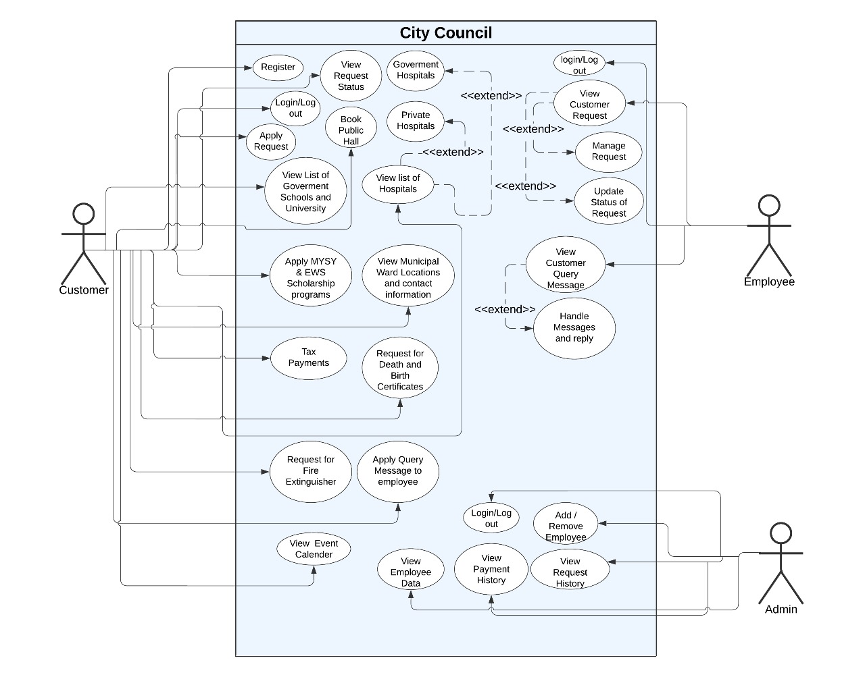
System Design (Use Case Diagram)

Slide 12
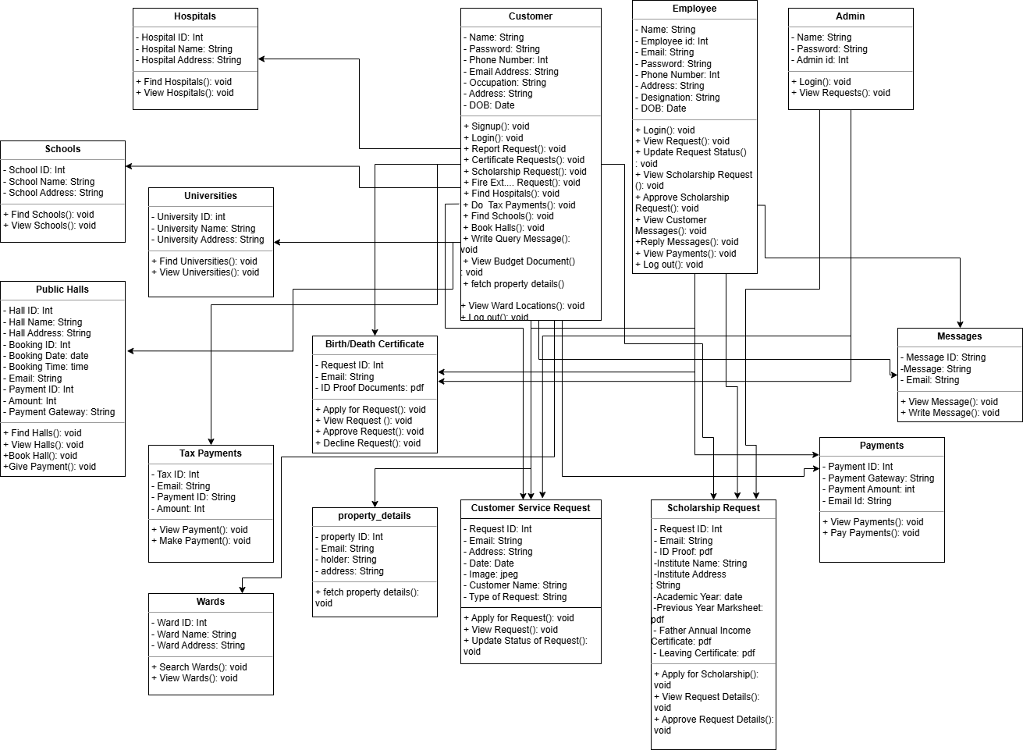
System Design (Class Diagram)

Slide 13
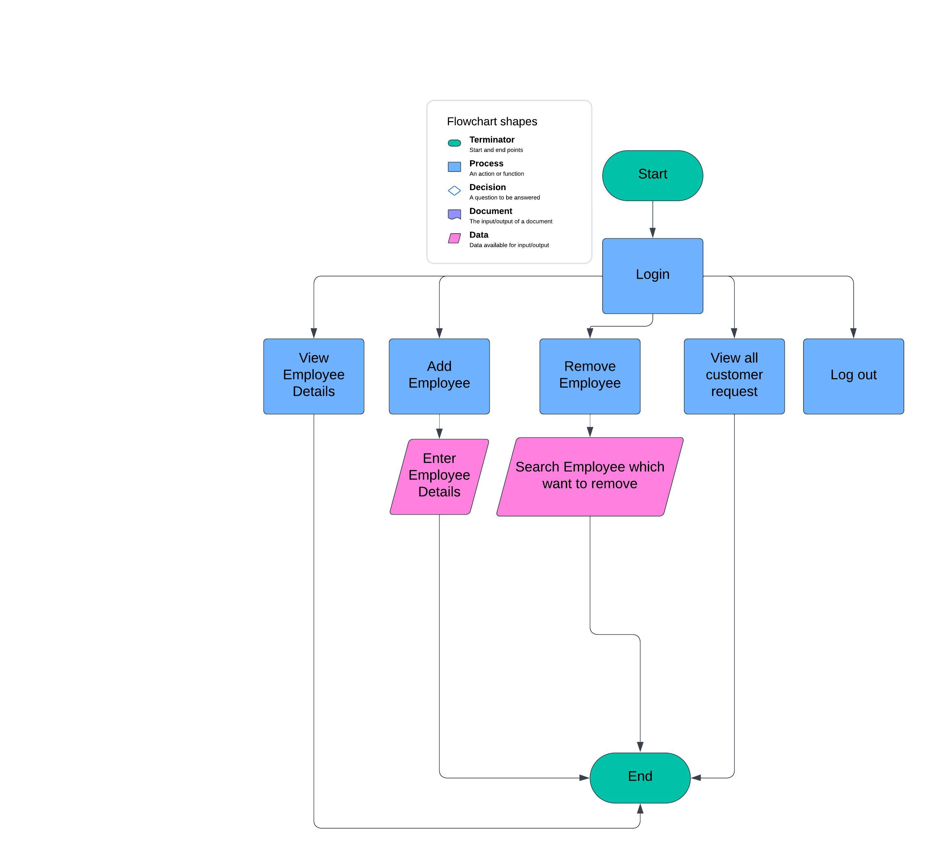
System Design (Flow Chart Admin)

Slide 14
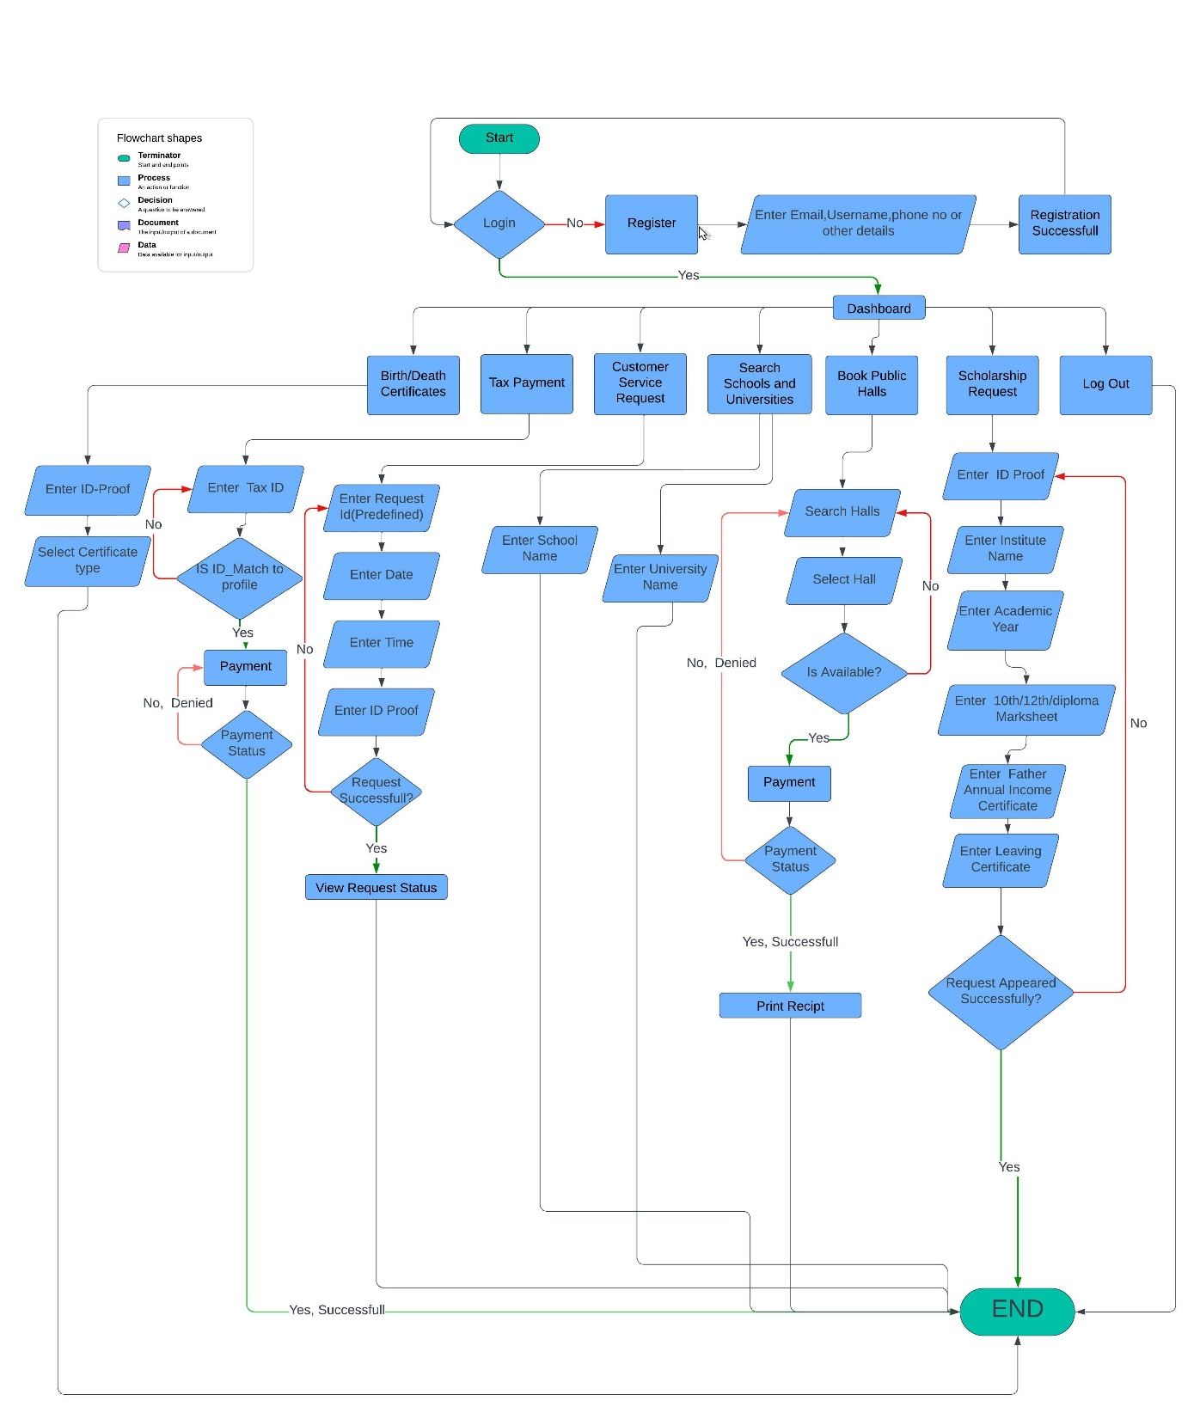
System Design (Flow Chart Customer)

Slide 15
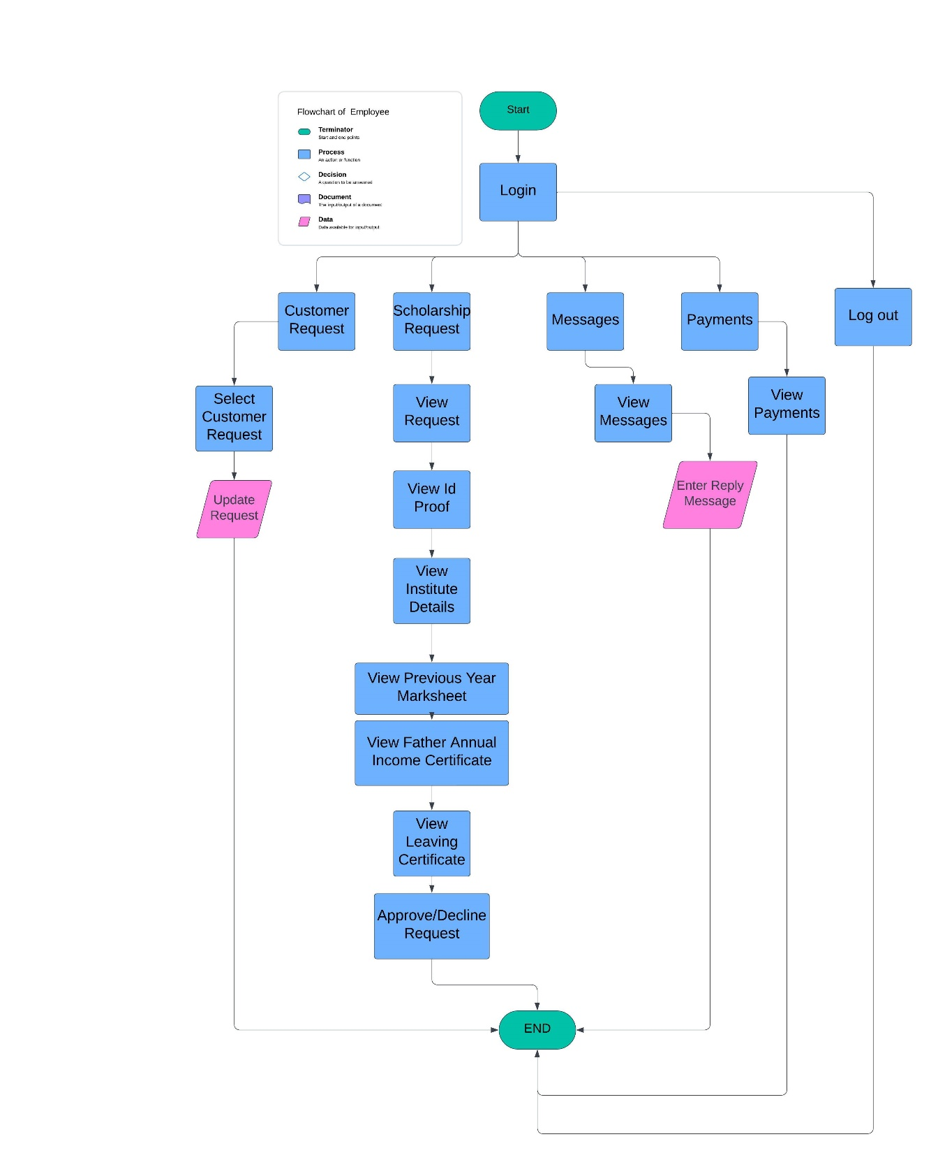
System Design (Flow Chart Employee)

Slide 16
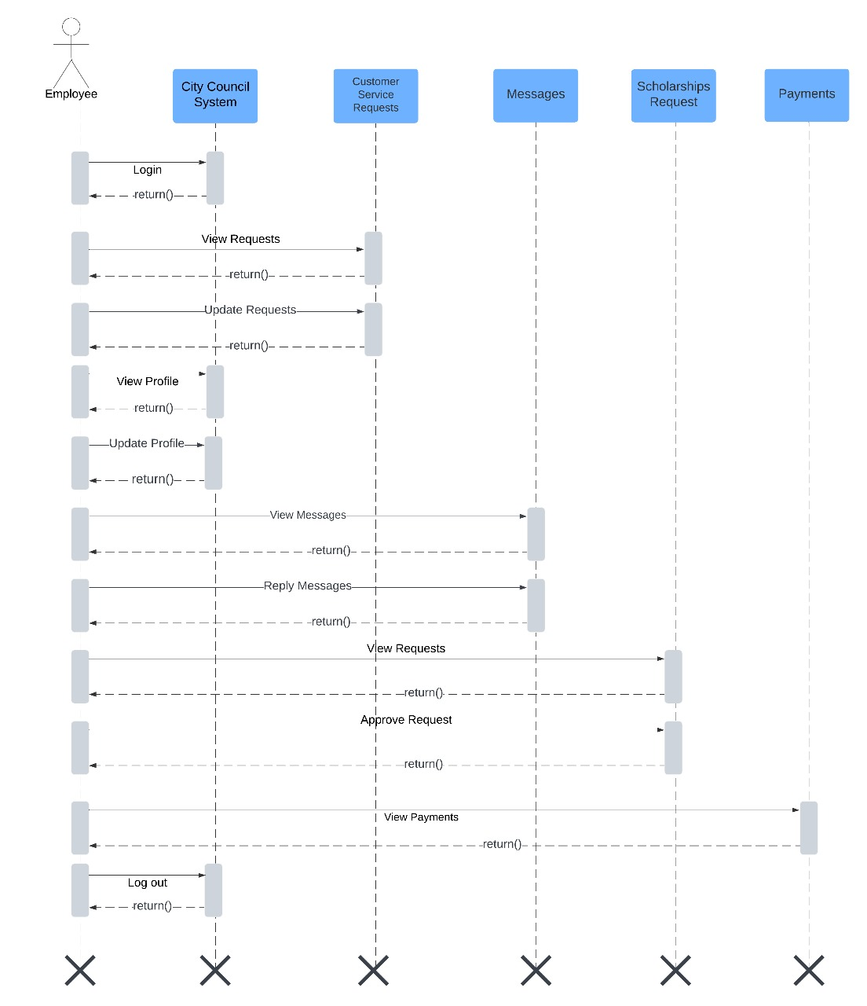
System Design (Sequence Diagram Employee)

Slide 17
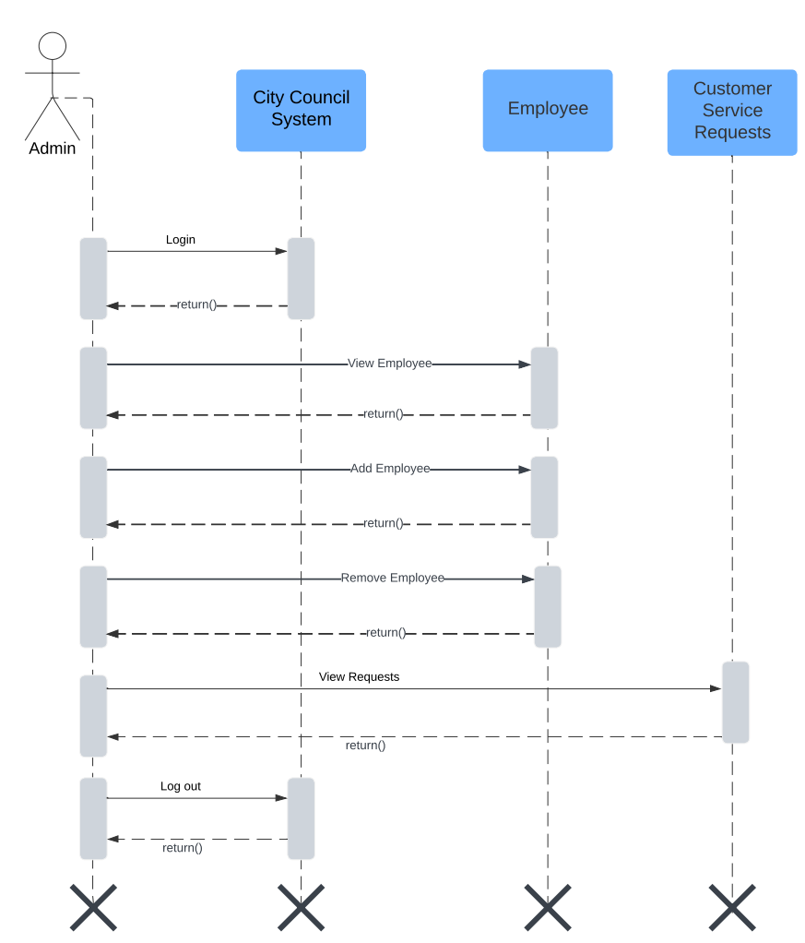
System Design (Sequence Diagram Admin)

Slide 18
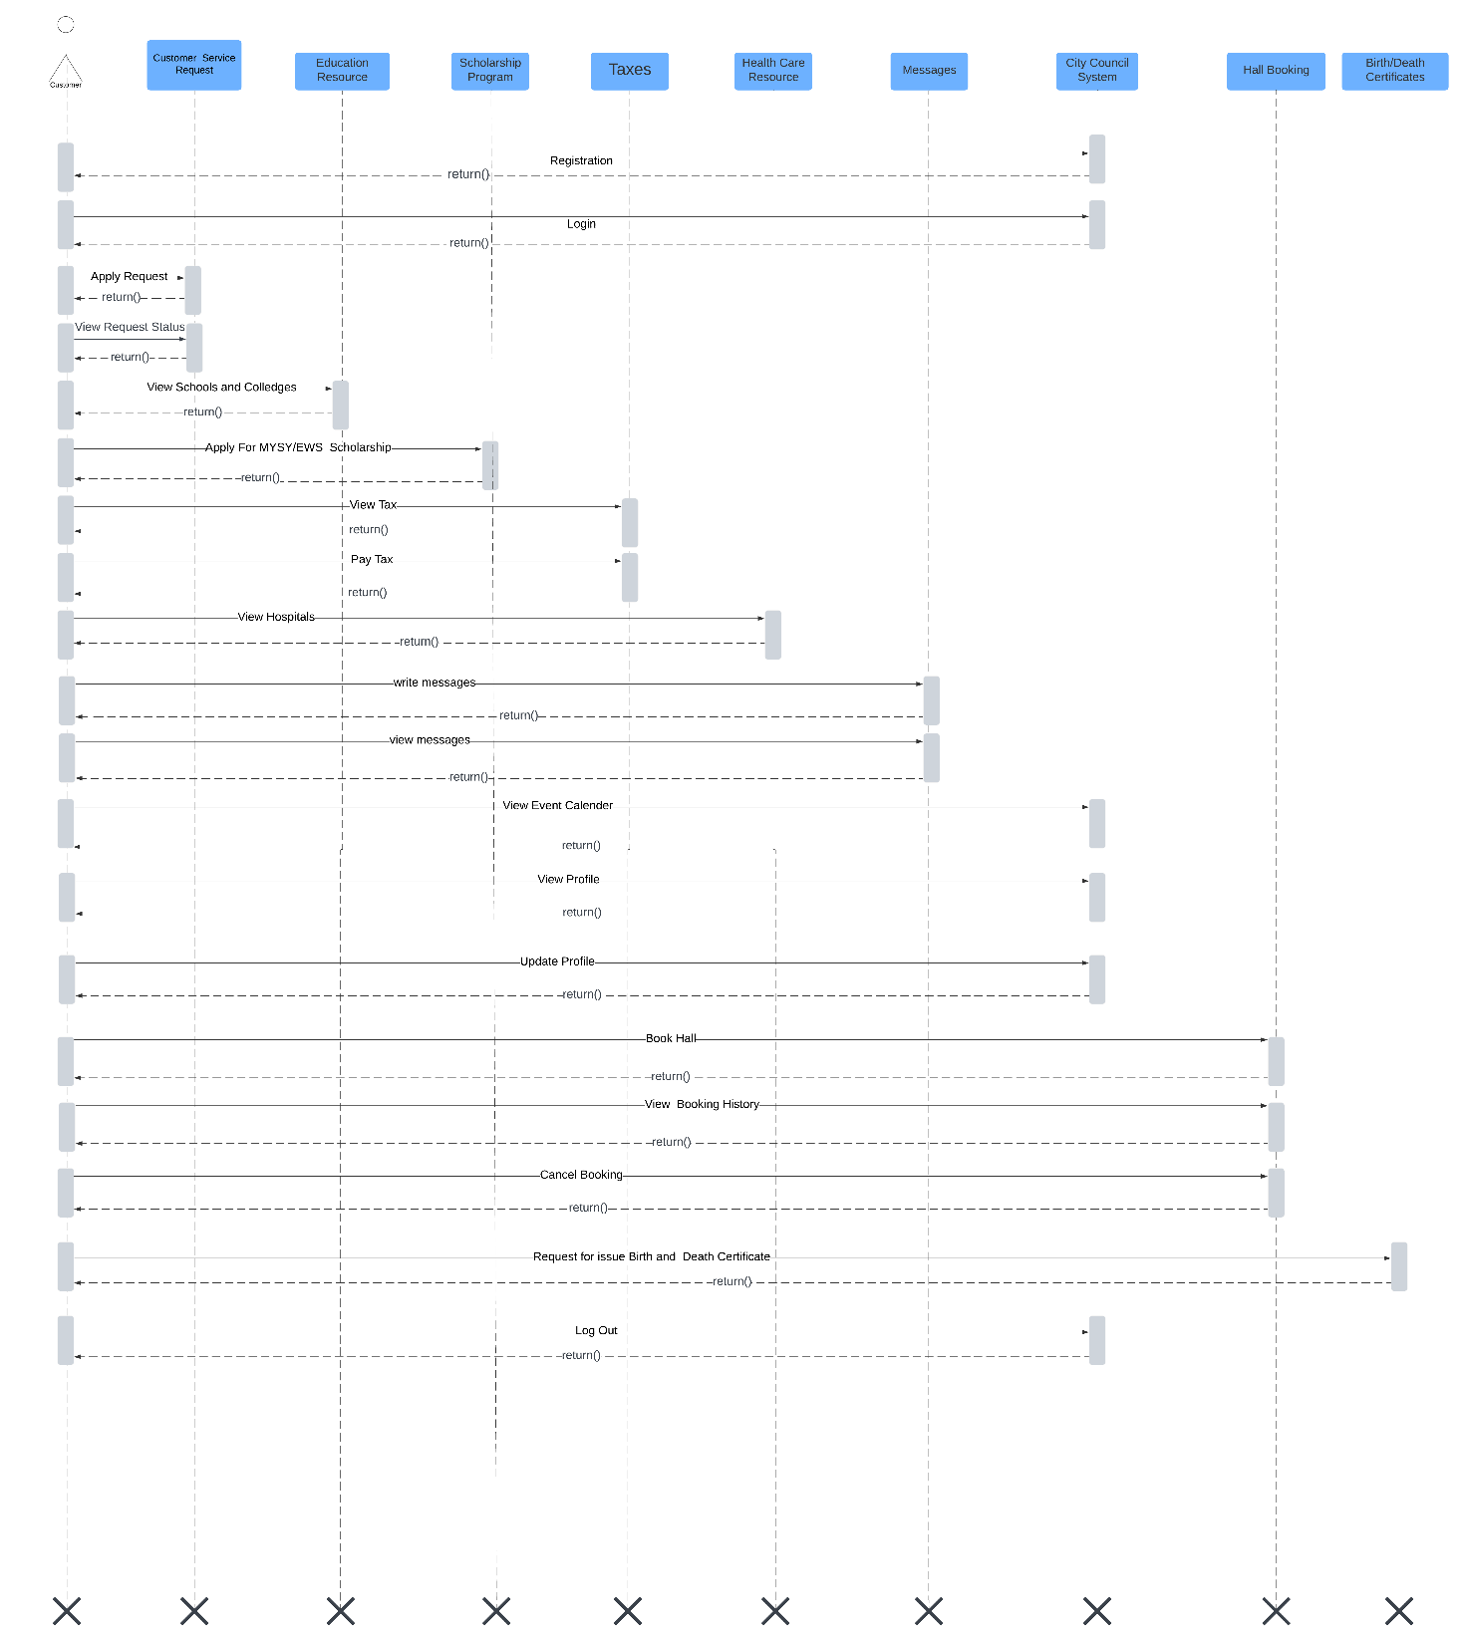
System Design (Sequence Diagram Customer)

Slide 19
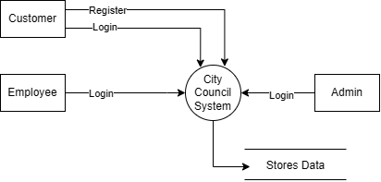
System Design (DFD Level 0 Diagram)

Slide 20
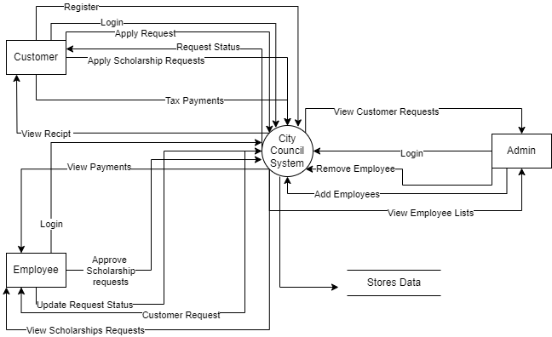
System Design (DFD Level 1 Diagram)

Slide 21
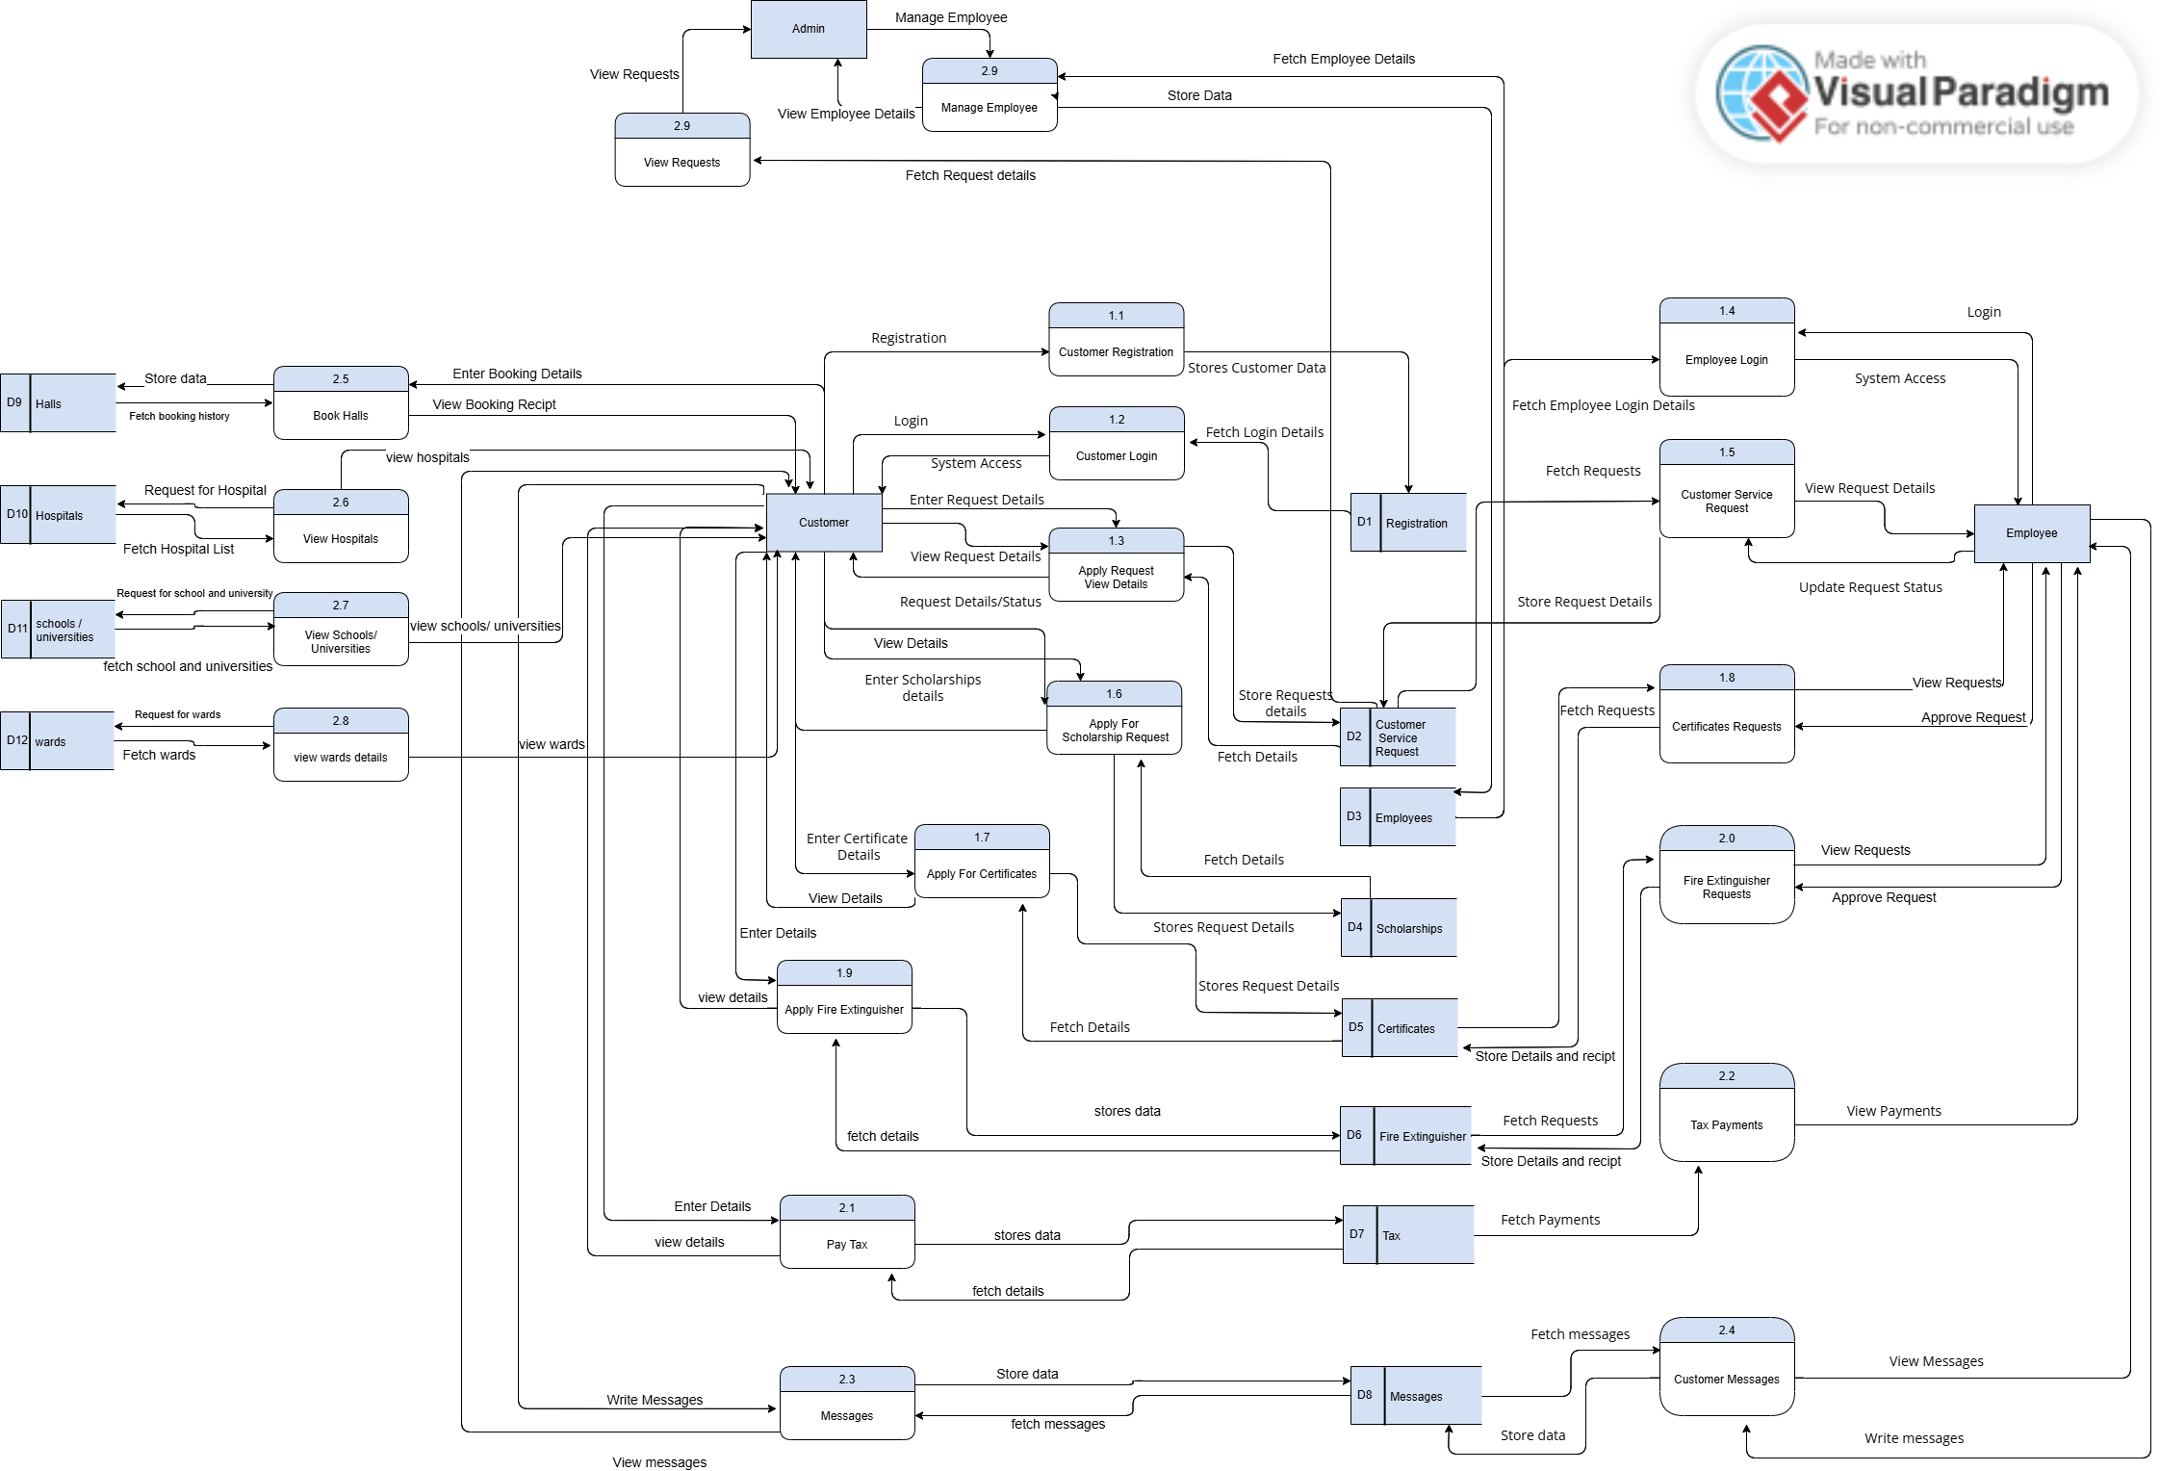
System Design (DFD Level 2 Diagram)

Slide 22
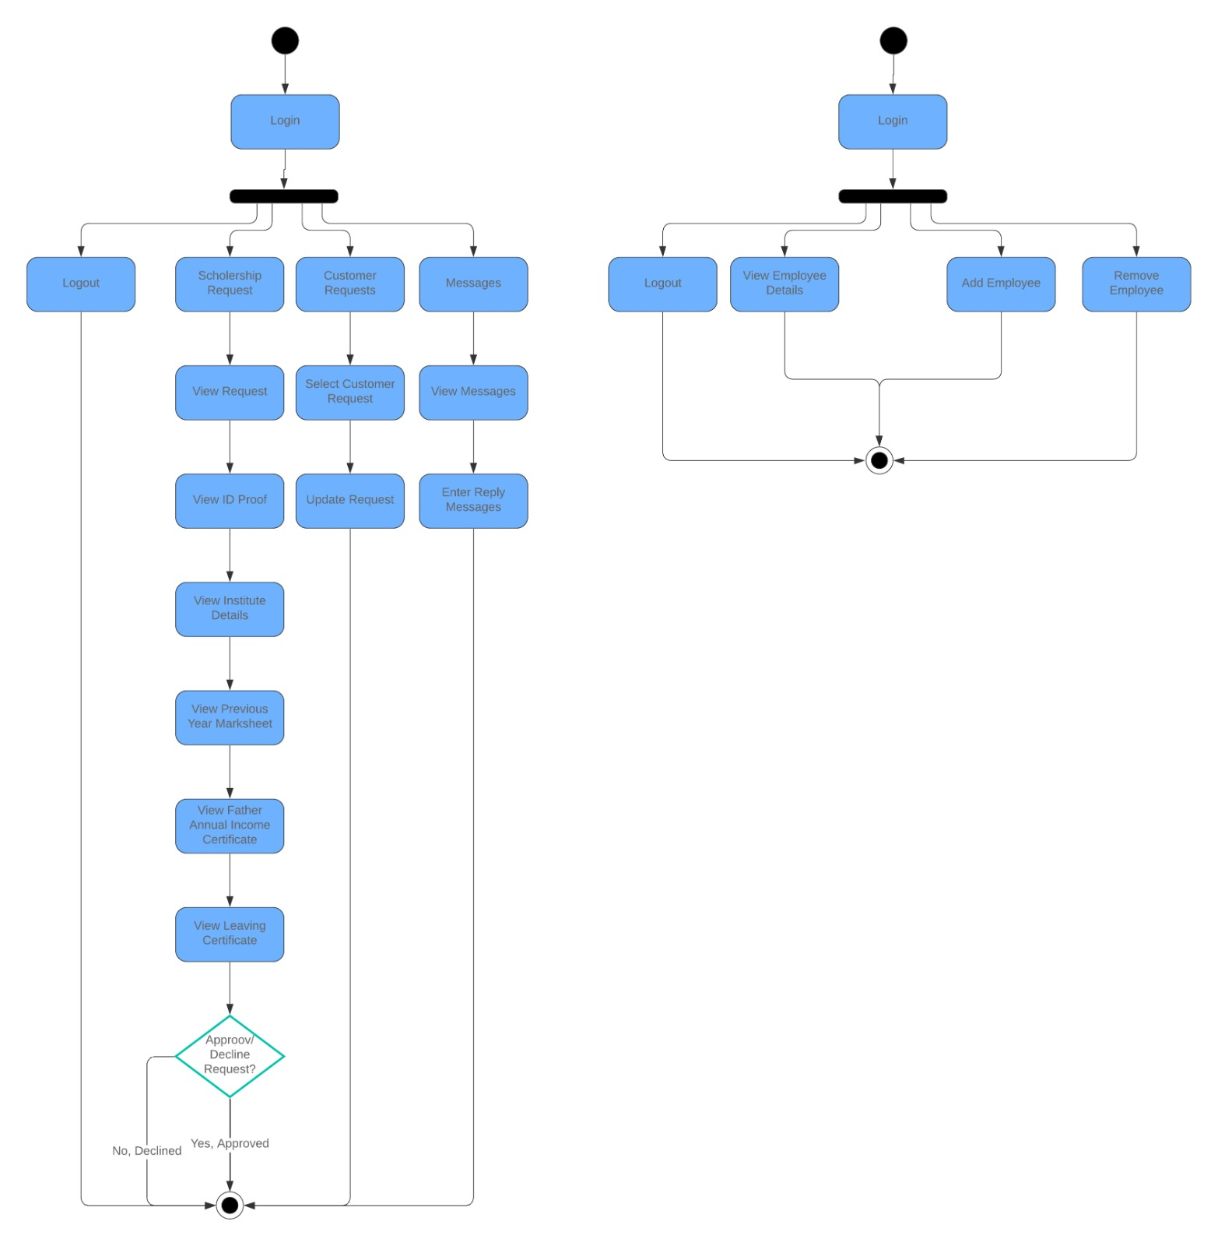
System Design (Activity Diagram Admin / Employee)

Slide 23
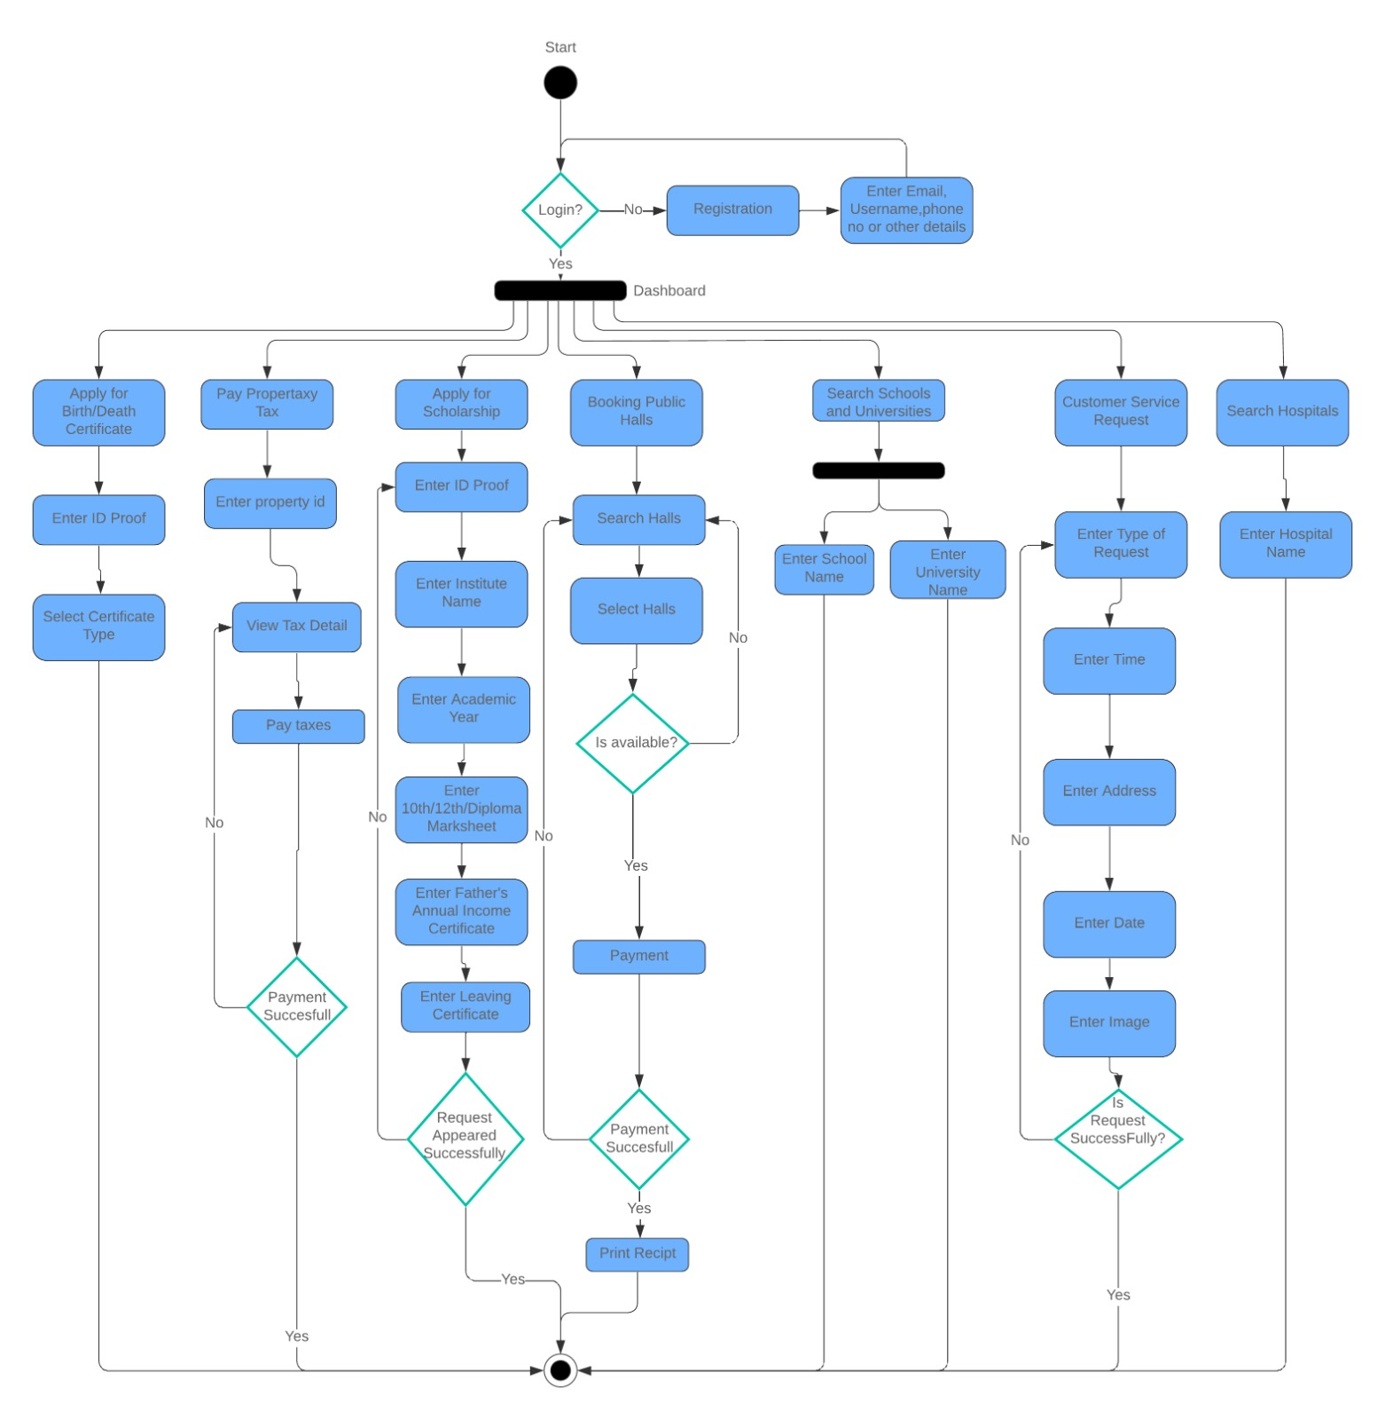
System Design (Activity Diagram Customer)

Slide 24
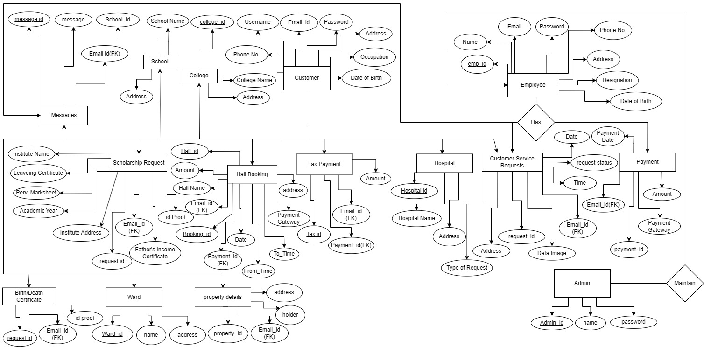
System Design (ER Diagram)

Slide 25
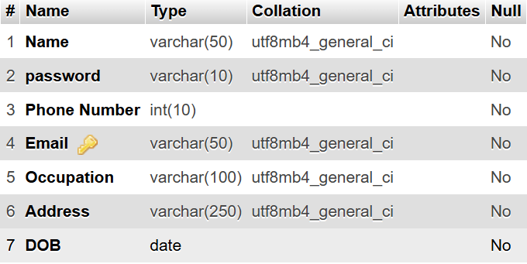
Table 1.1 Customer

Slide 26
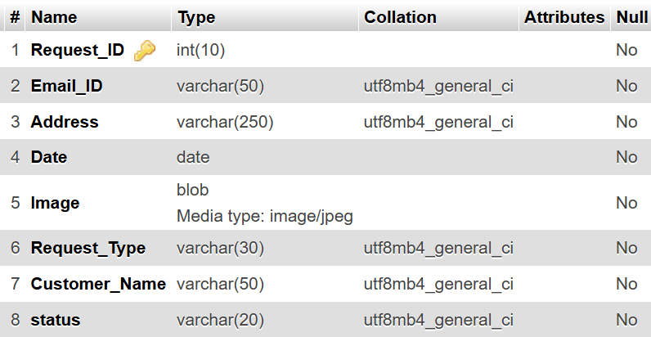
Table 1.2 Customer Service Request

Slide 27
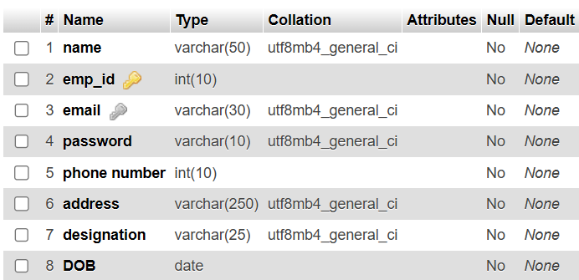
Table 1.3 Employee

Slide 28
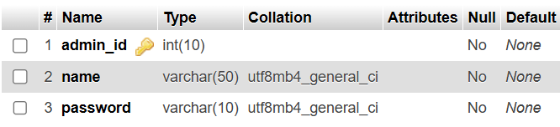
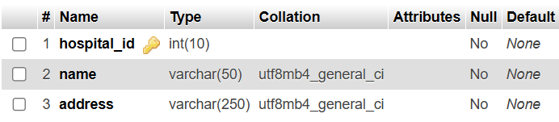
Table 1.4 Admin Table 1.5 Hospital

Slide 29
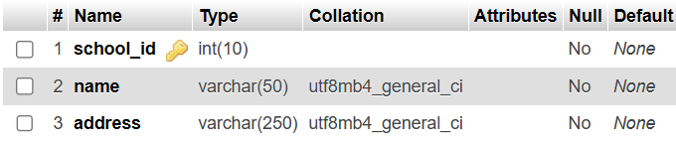
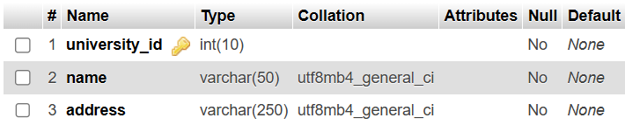
Table 1.6 School Table 1.7 University

Slide 30
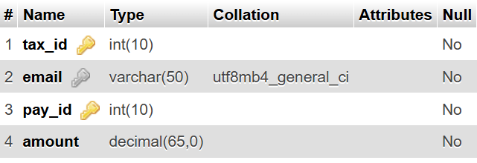
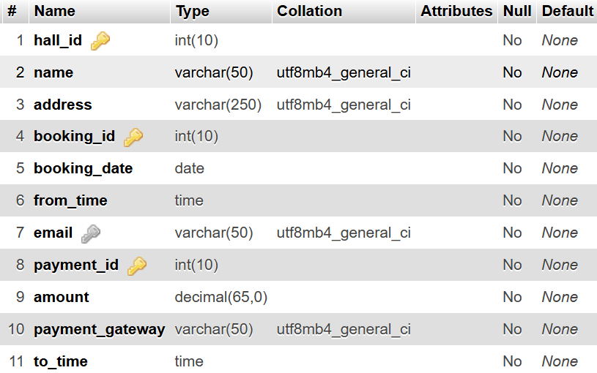
Table 1.8 Tax Payments Table 1.9 Hall Booking

Slide 31
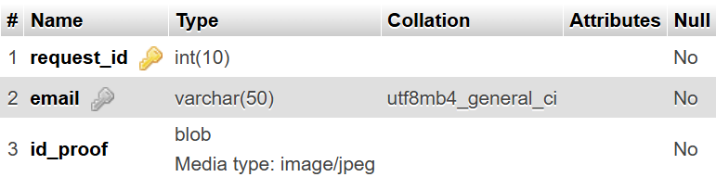
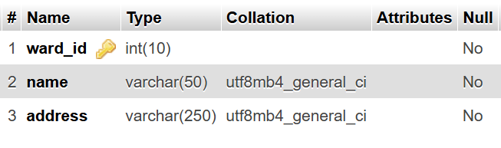
Table 2.0 Certificates Table 2.1 Wards

Slide 32
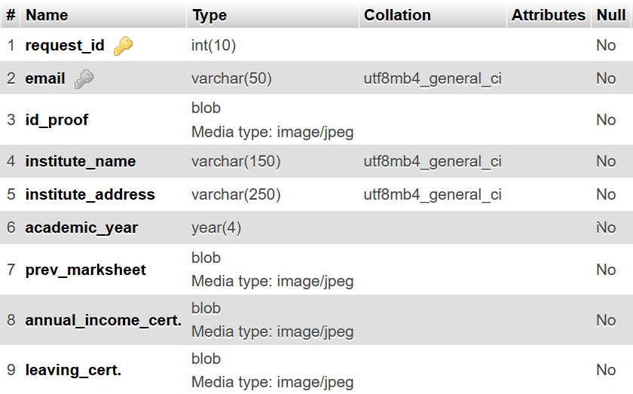
Table 2.2 Scholarships

Slide 33
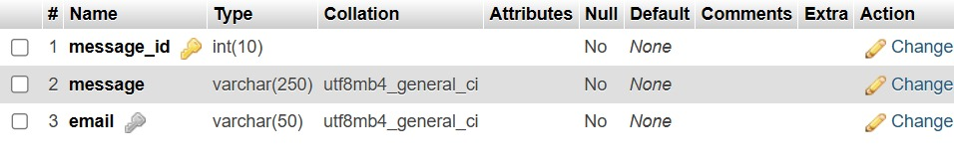
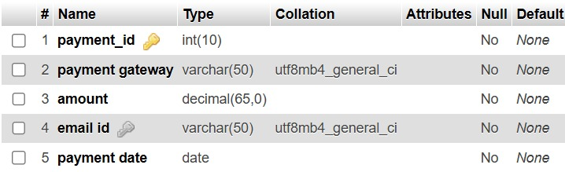
Table 2.3 Messages Table 2.4 Payments

Slide 34
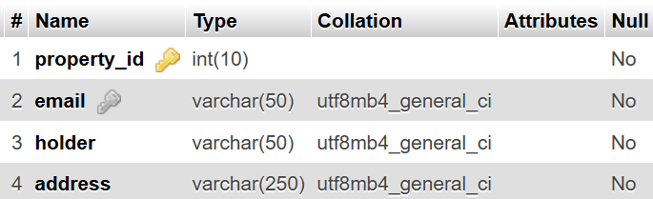
Table 2.5 Property_detail

Slide 35
Reference and Sources
https://online.visual-paradigm.com/
https://draw.io
www.lucidchart.com

Slide 36


